Slide 1
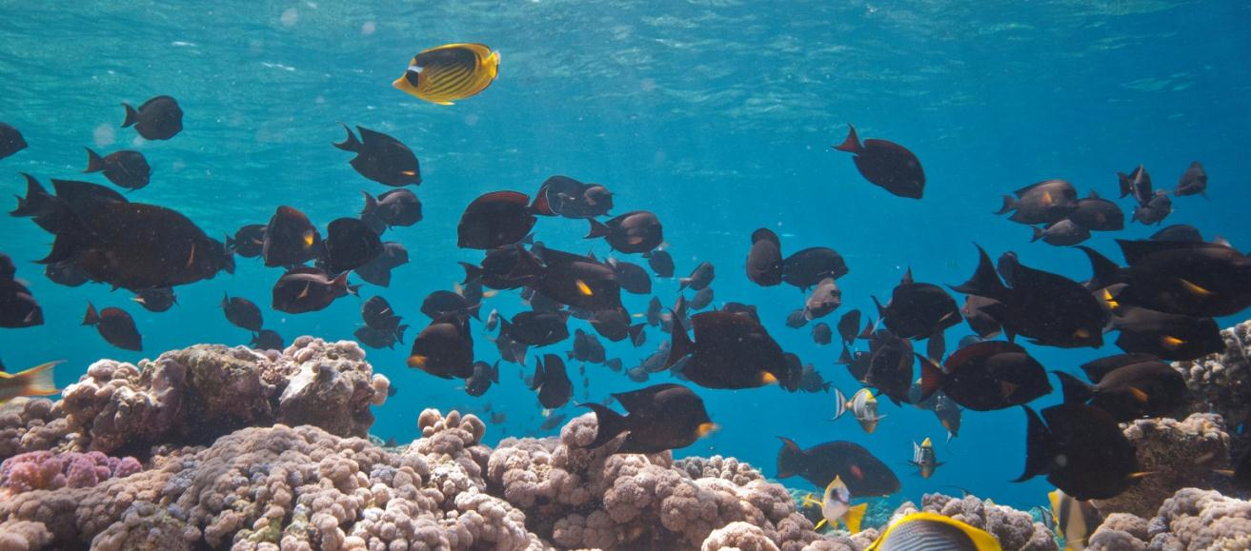

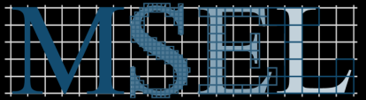
The ecological role of grazing surgeonfish on
Heron Island reef
© Mark Priest
Alyssa Marshell & Peter Mumby
Marine Spatial Ecology Lab
School of Biological Sciences
12th ICRS Cairns, July 2012

Slide 2
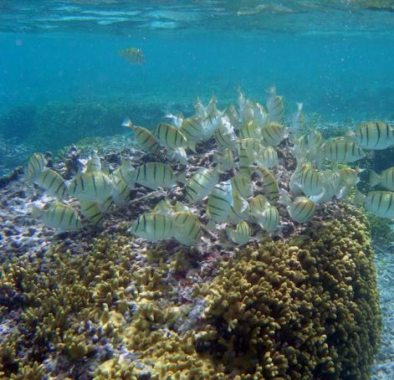
Herbivorous coral reef fishes
Main consumers of primary production (50 - 100% consumed daily)
Reduce algal establishment, growth & competition with corals
Increase availability of coral recruitment substrate
Structure benthic communities
Herbivory = key ecological process
- important for reef resilience
→ Essential to understand species-specific roles
Notes:
Herbivorous fish reduce growth of algal communities that compete with corals for space. Therefore, herbivory is widely acknowledged as a key ecological process that structures benthic communities and is important for the resilience of coral reefs. Investigating the different ecological roles of key herbivorous fish species is necessary for our understanding of reef resilience and targeted management plans.

Slide 3
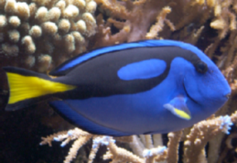
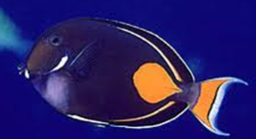
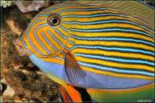
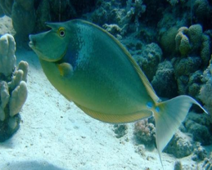
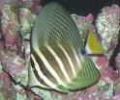
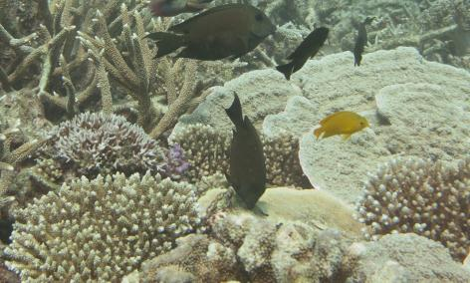

Acanthuridae (surgeonfishes, unicornfishes, tangs)
Widespread, common & abundant
Mostly herbivores (27/41 GBR species)
Little known of ecological roles of grazer/detritivores
- foraging morphology/strategies
- interspecific grazing relationships
- diet/trophodynamic analyses
-> investigate roles of key grazing surgeonfish spp.

Slide 4
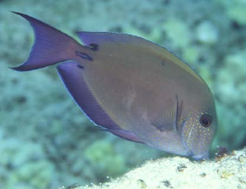
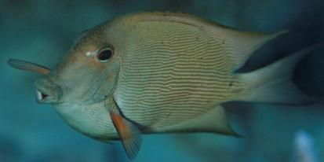
Common Indo-Pacific surgeonfish species
Acanthurus nigrofuscus - Brown surgeonfish
Grazer - Epilithic microalgae (crops)
Ctenochaetus striatus – Lined Bristletooth surgeonfish Detritivore - Detritus & sediment (brushes)
Both feed upon epilithic algal matrix
Grazing impact on algal turfs?
Objectives:
Individual impact = bite size/volume x # of bites per day
Population impact = mean abundance x individual impact
-> Aquaria experimental trials – bite size/volume & grazing impact
-> Field surveys – abundance, biomass, bite rates
Dense/Older
vs.
Sparse/Younger
Notes:
Striatus: Most studied surgeonfish – important role as detritivore – sediment dynamics
By brushing the reef, C. striatus
reduces the sediment loading in the epilithic algal matrix (EAM) while causing little damage to the
algal turf.

Slide 5


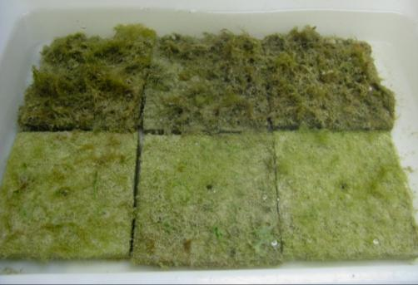
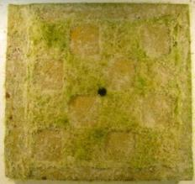
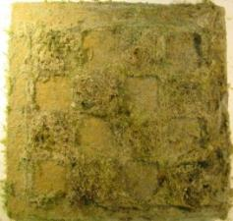
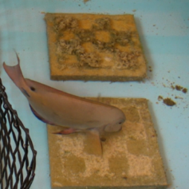
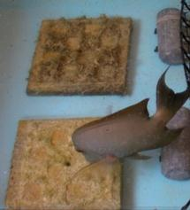
Methods – aquaria experimental trials
-> Algal turf biomass per bite/bite size
-> Grazing impact on algal turfs
Dense/long
Grazer Detritivore
n = 9, χ = 16.2cm n = 8, χ = 19.7 cm
vs.
Sparse/short
BEFORE & AFTER trial
Mean algal turf biomass (g C/cm⁻²)
Algal turf biomass per bite
mean biomass_{before} – mean biomass_{after}
no. of bites cm⁻²
Bite size – measure grazing scars
Notes:
Eight 2.5 x 2.5 cm squares scraped - Dried to constant weight at 60°C - Weighed to nearest 0.0001g - Organic fraction of algal samples (% ash free dry wt) - Reweigh samples after ashing at 500°C for 6 hours
To determine the algal biomass (in g ash-free dry wt [AFDW] cm⁻²) of each tile before and after each feeding trial, eight random 2.5 x 2.5 cm squares will be scraped, dried to constant weight at 60°C and weighed to the nearest 0.0001g. The organic fraction of algal samples (% AFDW) will be determined by reweighing samples after ashing at 500°C for at least 6 hours (Paine and Vadas 1969).

Slide 6
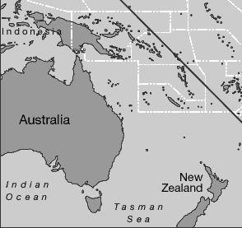
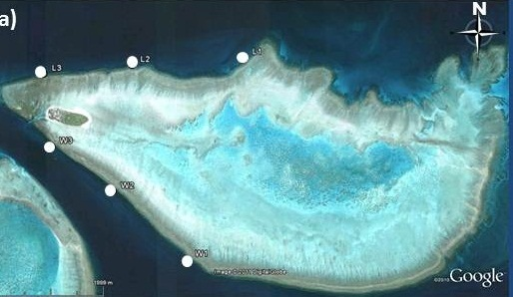

Methods - survey sites
Heron Island, southern GBR
Six sites
- 3 windward, 3 leeward
- Deep (12m), Shallow (4m)
Notes:
Fish kept in tanks and fed on coral rubble collected daily from reef flat………….not starved
Fish used in the laboratory for feeding trials will be captured from spur-and-groove reef habitat using a barrier net (25 x 1.5 m) herding technique. Captured fish will be kept in tanks at the laboratory with a continuous supply of flow-through seawater pumped directly from the reef, and fed daily with algae growing on coral rubble collected from nearby reef.

Slide 7
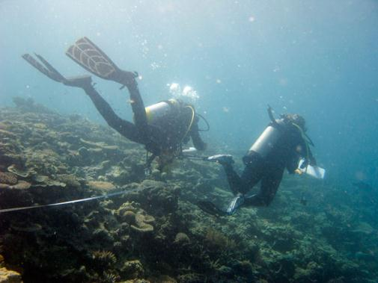

Methods – field surveys
Six sites
Herbivorous fish surveys
  8 x Deep, 8 x Shallow (30 x 5m)
  surgeonfish, parrotfish, rabbitfish
  Benthic photo quadrats, rugosity
  Morning surveys, at high tide
Key surgeonfish spp. bite observations
  5-min observations
  Mean # bites per day
Notes:
Pre-conditioned limestone tiles (13 x 13 x 1.5cm), Scrubbed gently = ~ 0 algal biomass, Deployed to shallow trough raceways, Unfiltered flow-through seawater, Moderate flow, partly shaded →Epilithic turf algal growth within 5 days
Pre-conditioned limestone tiles (13 x 13 x 1.5 cm) with a rough textured surface will be placed in shallow troughs with flow-through unfiltered seawater pumped from the reef to develop homogenous epilithic turf algal growth. To allow different stages of turf algal development to be achieved, tiles will be placed into troughs in phases, resulting in tiles with ~ 2-week-old growth and ~ 6-week-old growth

Slide 8
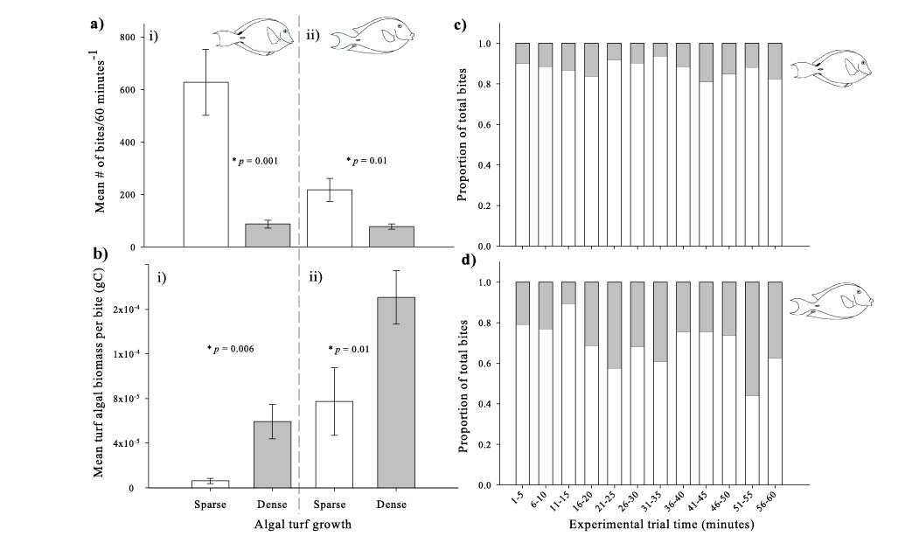

Number of bites
-> Sparse turf preferred
Grazer Detritivore
Notes:
Eight 2.5 x 2.5 cm squares scraped - Dried to constant weight at 60°C - Weighed to nearest 0.0001g - Organic fraction of algal samples (% ash free dry wt) - Reweigh samples after ashing at 500°C for 6 hours
To determine the algal biomass (in g ash-free dry wt [AFDW] cm⁻²) of each tile before and after each feeding trial, eight random 2.5 x 2.5 cm squares will be scraped, dried to constant weight at 60°C and weighed to the nearest 0.0001g. The organic fraction of algal samples (% AFDW) will be determined by reweighing samples after ashing at 500°C for at least 6 hours (Paine and Vadas 1969).

Slide 9
Mean biomass per bite
Grazer Detritivore
-> Sparse turf preferred
-> Dense = more turf per bite
Notes:
Eight 2.5 x 2.5 cm squares scraped - Dried to constant weight at 60°C - Weighed to nearest 0.0001g - Organic fraction of algal samples (% ash free dry wt) - Reweigh samples after ashing at 500°C for 6 hours
To determine the algal biomass (in g ash-free dry wt [AFDW] cm⁻²) of each tile before and after each feeding trial, eight random 2.5 x 2.5 cm squares will be scraped, dried to constant weight at 60°C and weighed to the nearest 0.0001g. The organic fraction of algal samples (% AFDW) will be determined by reweighing samples after ashing at 500°C for at least 6 hours (Paine and Vadas 1969).

Slide 10
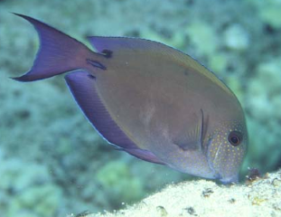
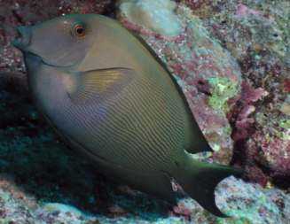
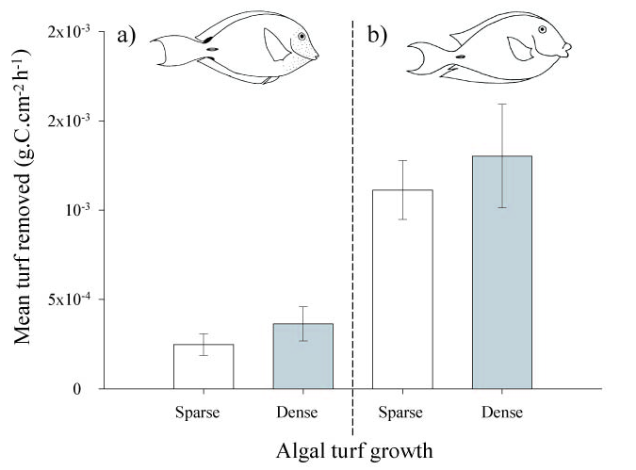
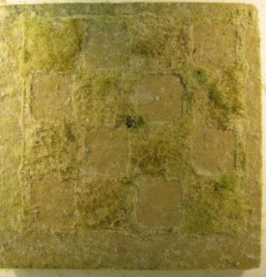
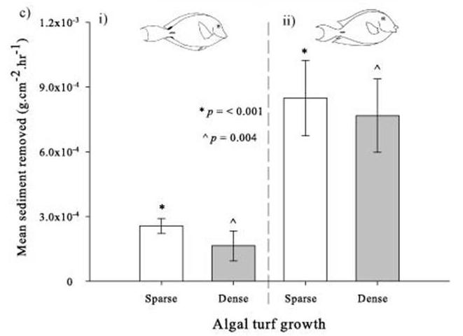
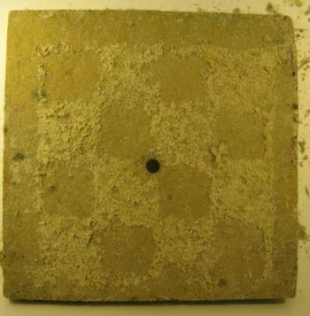
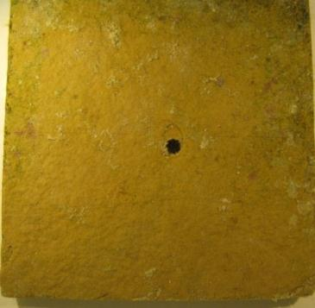
Aquaria trials – removed biomass
Grazer
vs.
Detritivore
Sediment removed
Turf removed
BEFORE →
BEFORE →
^
*
* p = < 0.001
^ p = < 0.004
^
*
AFTER →
→ Detritivore removed more turf than grazer
Notes:
This dentition form and the ‘V’-shaped lower jaw of Ctenochaetus appear to restrict it from effectively cropping turf algae.
confident that this species is targeting sediments, detrital material and the associated microbial biomass
microalgae were a minority component of the ‘‘unidentified organic matter’’ and no more abundant than material of invertebrate
origin. Individual algal filaments were observed, but it was unclear whether this was grazed from the substratum or represented detrital elements.
microalgae were a
minority component of the ‘‘unidentified organic matter’’
and no more abundant than material of invertebrate
origin. Individual algal filaments were observed,
but it was unclear whether this was grazed from the
substratum or represented detrital elements.

Slide 11
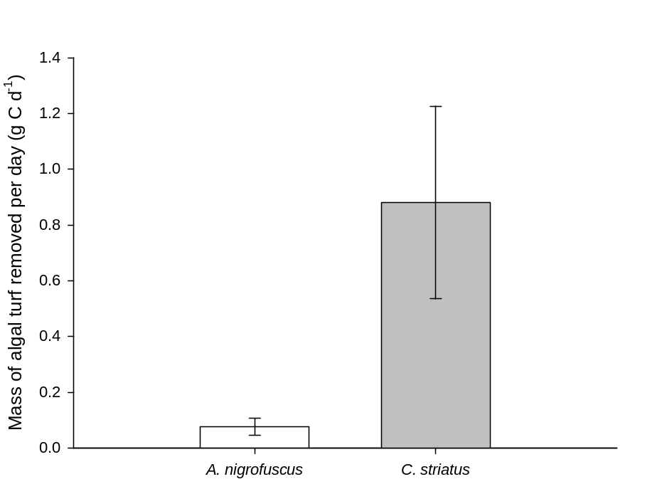


Individual Grazing Impact
Turf removed (g.C.day⁻¹)
= Bite volume (g) × # of bites/day
- sparse turf data
0.88
0.07

Slide 12
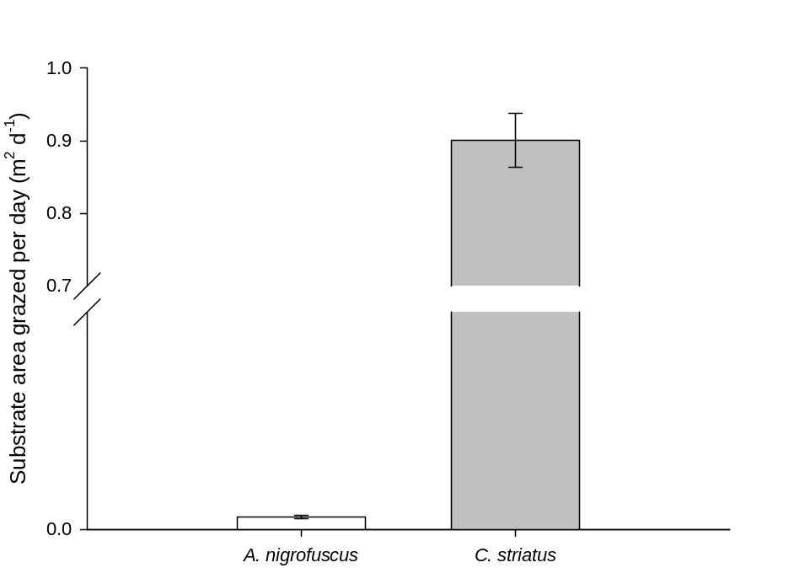

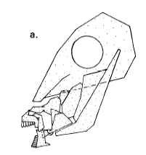

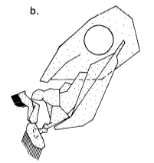
Individual Grazing Impact
Turf removed (g.C.day⁻¹)
= Bite volume (g) × # of bites/day
- sparse turf data
= Bite size (m²) × # of bites/day
0.88
0.07
Area grazed (m² day⁻¹ )
0.002 ± 0.0003 cm²
0.8 ± 0.03 cm²
0.9
0.003
112.8° gape
177.6° gape
(Purcell & Bellwood 1993)

Slide 13
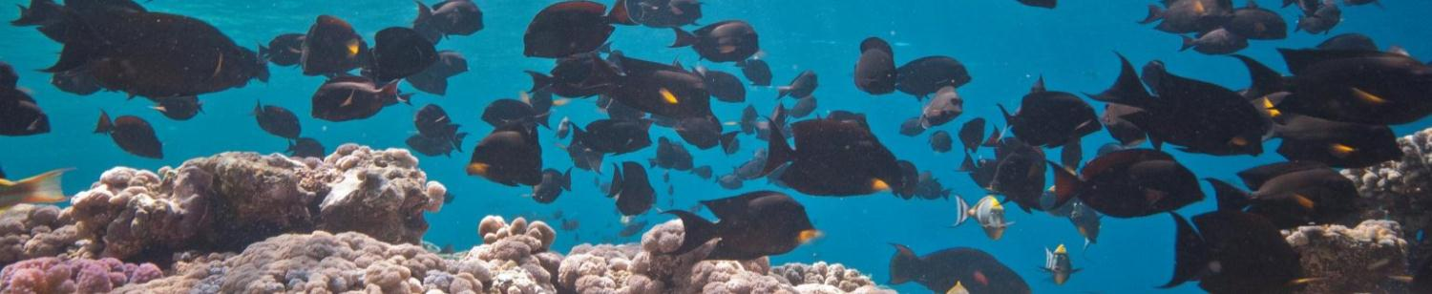
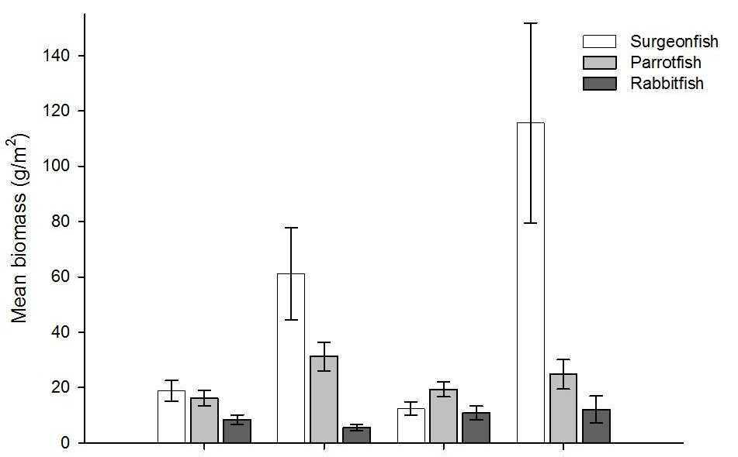
  Fish survey data - Herbivorous fish mean biomass (g/m²)
-> Surgeonfish - dominate biomass at shallow depths
Leeward
Windward
Deep
Shallow
Deep
Shallow

Slide 14

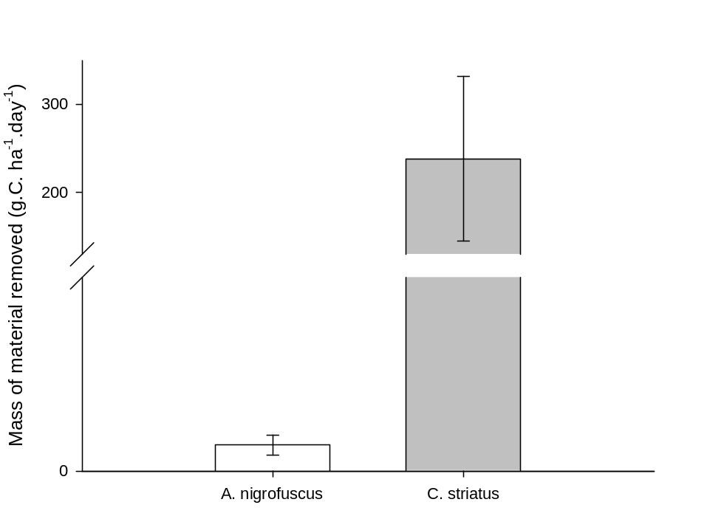
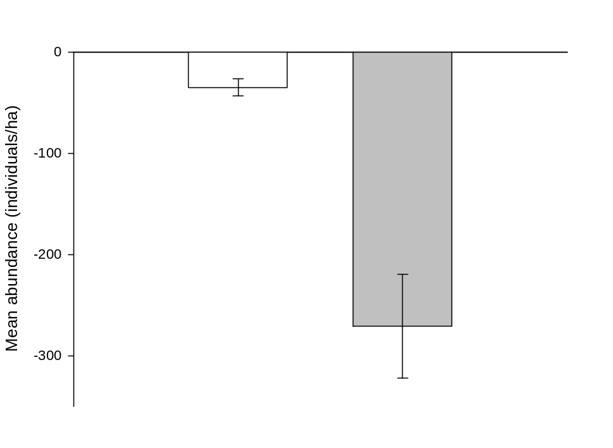
Population Grazing Impact
Mass removed (g.C.ha⁻¹.day⁻¹)
239 g
2.7 g
= Individual impact × mean abundance
Size class 15 - 20cm
Sparse turfs
Shallow reef slope (~4m)
Abundance (individuals/ha)
v

Slide 15
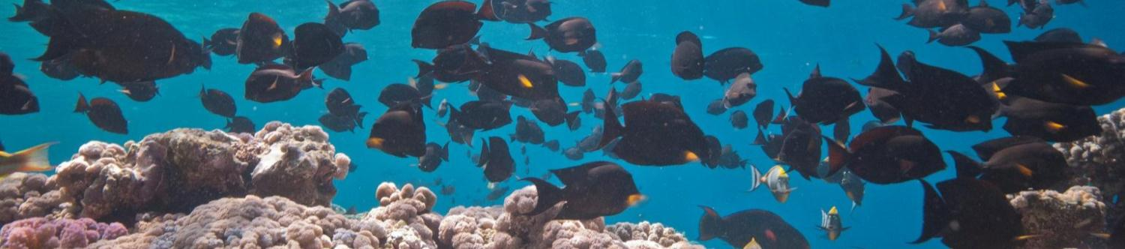
Summary
Most abundant surgeonfish species - detritivorous Ctenochaetus spp.
- previously thought to cause little damage to algal turfs
- capacity to remove significant quantities of algal turfs
Need to quantify Ctenochaetus impact on algal turfs on the reef
Reconsider role of Ctenochaetus spp. in algal turf dynamics
Revaluate exclusion of Ctenochaetus from resilience monitoring

Slide 16
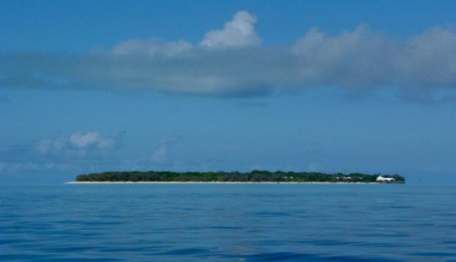

Acknowledgements
Volunteers: Julia Lawson, YY Chang, Chris Doropoulos, George Roff, Mark Priest
Heron Island Research Station Staff
Marine Spatial Ecology Lab
ARC Laureate Fellowship Funding (Peter Mumby)
Photo Credits: Mark Priest, www.hawaiifishes.com, www.guamreeflife.com
Marshell, A. Mumby, P.J. (2012) Revisiting the functional roles of the surgeonfish Acanthurus nigrofuscus and Ctenochaetus striatus.
Online First, Coral Reefs

Slide 17
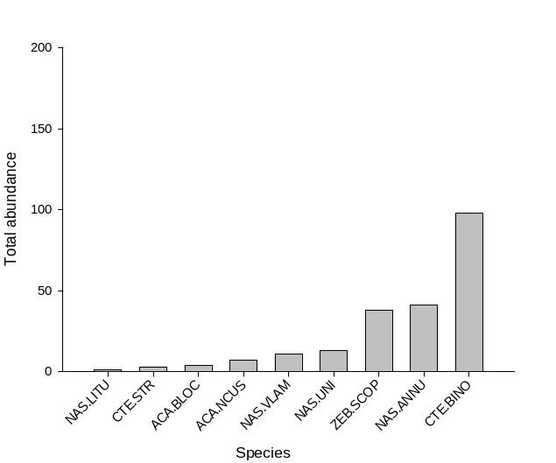
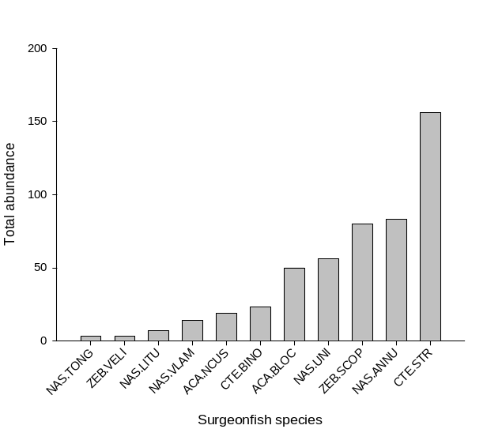
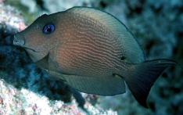
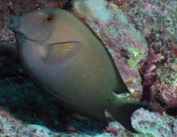
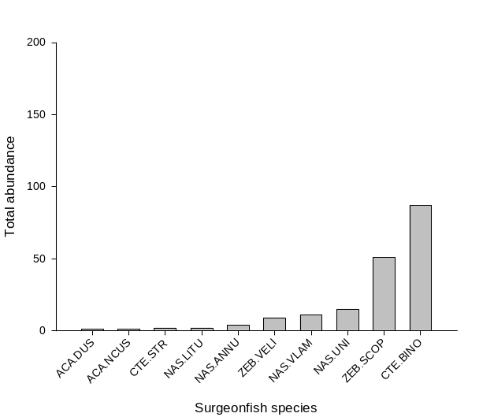
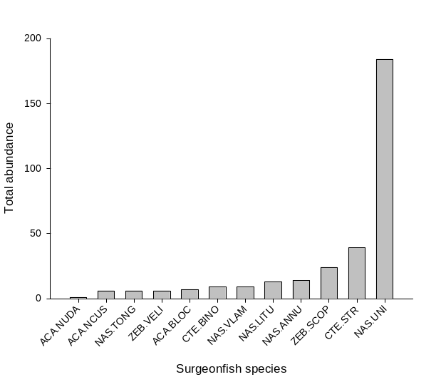

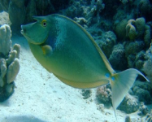
  Most abundant surgeonfish
Leeward Deep
Leeward Shallow
Windward Deep
Windward Shallow

